Slide 1
Distributed OSGi in Runtime Project
Scott Lewis
EclipseSource, Inc.
Eclipse Communication Framework http://www.eclipse.org/ecf

Slide 2
Use Cases for Distributed OSGi Services
Remote Provisioning (Jeff McAffer)
  http://eclipsesource.com/blogs/2009/05/05/remote-provisioning-with-p2/
  Remote access/use of p2 engine, planner, profileRegistry
  Server-managed profiles
Load Balancing OSGi Services
  Load balancing service invocations/method calls among target servers
  EclipseSource Yoxos Enterprise: OSGi server that creates Eclipse configurations
    Distributes P2 planner requests among set of planner servers
  Can reuse same infrastructure for any OSGi service
Remote Services + Declarative Services
  Dependency injection and remote services...nice way to build SOA servers
Lots of others
  Modular webservers

Slide 3
OSGi Services: Just Works
OSGi services provide
  Encapsulation
  Loose coupling
  Extensibility and Abstraction
Well-worn: In place in OSGi spec and functioning impls for many years
  Extensibility Underneath Eclipse
    Implements Eclipse plugin model
    Implements Eclipse extension registry
  Present in commercial app servers
    BEA Weblogic (now Oracle)
    IBM Websphere
    Others
Great Intro/Description of OSGi services
  Symmetric Service Oriented Programming (BJ Hargrave) : http://live.eclipse.org/node/778
Interface
Implementation

Slide 4
How are OSGi Services Exposed and Used?
Registration - 'service host'
  BundleContext.registerService(...)
Lookup/Finding - 'service consumer'
  BundleContext.getServiceReferences(...)
  BundleContext.getService(ref)
Use (consumer)
  Call methods on interface
    Implementing object's code is synchronously run
Clean-up
  Releasing References (gc for dynamic services)
    ServiceRegsitration.unregister, BC unget(reference)
Code example
Interface
Implementation

Slide 5
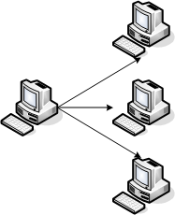
Distributed OSGi == OSGi Services Over Network
Registration
  New step: publication for network discovery
Lookup
    Network discovery for finding service (not all services are 'just there')
Cleanup
  Guarantee cleanup in unreliable network
Other things unique to remote services
  Marshalling/Serialization issues
  call by reference vs. call by value
  failure handling
  Rpc (blocking/synchronous calls) in failure-prone environment

Slide 6
Distributed OSGi Specification: RFC119
OSGi Alliance Enterprise Experts (EE) Group
OSGi 4.2 (Early 2010 finalization)
Drafts available now: http://www.osgi.org/Specifications/Drafts
ECF 3.0/Galileo Implemented Draft Equinox Runtime
Will have continue to have spec-compliant implementations
  Scott not spec author (focus on impls in Equinox)
  Frequently complains (aka contributes) to spec authors
  Jan Rellermeyer...r-OSGi creator and ECF committer...is in EE working group
  ECF's remote services API has features not yet in RFC119
    Asynchronous messaging support (e.g. futures and listeners)

Slide 7
Distributed OSGi - Architecture
Subsystems
  Discovery
      Service Publication (service host) and discovery (consumer)
  Distribution
      Creation/access to proxy
      Marshalling/Serialization (e.g. parameters)
      Currently: Spec defines proxied RPC...i.e. blocking call/return
Spec does not define wire protocol for either discovery or distribution
  Allows multiple protocols to be accomodated

Slide 8
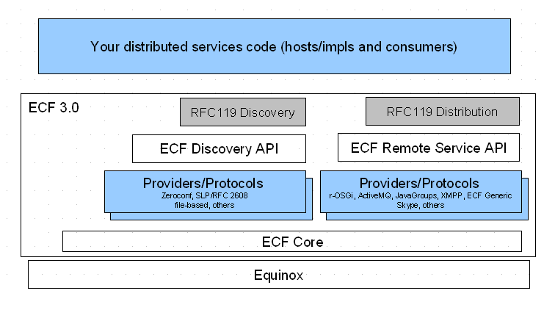
ECF 3.0/Galileo Implementation

Slide 9
ECF Remote Services
Protocol agnostic API for doing remoting
Like Local OSGi Services
  Registration
      registerRemoteService(...)
  Lookup
      IRemoteServiceReference ref = getRemoteServiceReferences(...)
  Cleanup
      unregister/unget
Used ECF Discovery and Remote Services API to implement RFC 119
  Programmer can use transparent registration/lookup from RFC119
  Or non-transparent registration/lookup via ECF RS

Slide 10
ECF Remote Services Providers
R-OSGi
ECF Generic
XMPP
JMS (ActiveMQ but other JMS impls trivial to create)
Skype
JavaGroups
REST: Google SOC 2009 project http://wiki.eclipse.org/Google_Summer_of_Code_ECF_Projects_for_2009
Others pending: Riena, SOAP-based, commercial/closed, CXF, etc
Any/all ECF RS providers get ongoing, free support for RFC 119

Slide 11
ECF Discovery API
A protocol agnostic API for service discovery
  Does not expose provider/protocol internals
    Allows flexibility in service addressing
  Not limited to the local subnet (LAN)
    However some providers/protocols are restricted
  No guarantees (just because something is discoverable, does not mean it is there)
    Upper layers may fail to connect
Provides IDiscoveryLocator and IDiscoveryAdvertiser
  Locator finds services
  Advertiser registers/announces services

Slide 12
ECF Discovery Providers
Zeroconf/Bonjour
Service Locator Protocol (IETF RFC2608)
Composite provider
File-based discovery (xml)
Others being created
  private/commercial
  Other protocols...e.g. XMPP discovery, UPnP

Slide 13
RFC 119
Transparent Registration, Lookup, and Cleanup
  BundleContext.registerService and BundleContext.getServiceReferences
  Don't have to be concerned with details of publication/discovery, network lookup, proxy creation, etc
Two new service properties
    Registration: osgi.remote.interfaces
      Indicates to distribution provider that it should publish/remote the service
    Consumer: osgi.remote
      Indicates to consumer that service is remote

Slide 14
Do we want network transparency?
Some unavoidable differences between local and RPC
  Performance
  Reliability
  Marshalling
Can't Fix Network/Can't Ignore/Hide Network...so what to do?
  Note on Distributed Computing
  OSGi's Service Model is Dynamic
  Consumers must deal with services coming and going in regular OSGi services
  Can use dynamic services to represent network failure (service disappears)
  We want to allow/support programmers in using both transparent and non-transparent usage

Slide 15
ECF → Transparent or non-transparent remoting
Exposes IRemoteService
Provides proxy AND other calling patterns to consumer
AsyncExec, Future, One-Way all available
  AsyncExec, Future, One-Way all available
    RemoteServiceTracker (ServiceTracker for IRemoteServices)
    IRemoteService getRemoteService() rather than Object getService()

Slide 16
Other exciting things in ECF project
GSOC: REST provider support
  http://wiki.eclipse.org/REST_abstraction_for_ECF
GSOC 2009: SIP/VOIP
  http://socghop.appspot.com/student_project/show/google/gsoc2009/eclipse/t124022231030
GSOC 2009: Google Services Provider
  http://socghop.appspot.com/student_project/show/google/gsoc2009/eclipse/t124022232038
GSOC 2009: Distributed testing framework
  Testing Distributed OSGi – based apps
Real-time Shared Editing
  EclipseDay talk last year: http://live.eclipse.org/node/543
ECF Provider for Google Wave
  http://eclipsesource.com/blogs/2009/06/15/google-wave-and-ecf/
  Implement Google Wave server-to-server protocol as ECF provider

Slide 17
Reference Distributed OSGi links from EclipseCon 2009
“Distributed OSGi Demo”
http://www.eclipsecon.org/2009/sessions?id=251
“Best Practices for Distributed OSGi Services” http://www.eclipsecon.org/2009/sessions?id=633
“Distributed OSGi Services”
http://www.eclipsecon.org/2009/sessions?id=757
“Distributed OSGi”
http://www.eclipsecon.org/2009/sessions?id=756

Slide 18
ECF Provider Architecture
Application
Eclipse, RCP, Equinox Server
Register
Lookup
r-osgi(1)
Registration and Lookup
Container Adapters
Remote Services
Discovery
File Transfer
Shared Editing
Presence
VOIP/Call Setup
factory
ECF Core
Datashare
Shared Object
r-OSGi‏
ECF
JMS
others...
OSGi/Equinox
API
Provider/Impl
IAdaptable

Slide 19
File based discovery
<?xml version="1.0" encoding="UTF-8"?>
<service-descriptions xmlns="http://www.osgi.org/xmlns/sd/v1.0.0">
<service-description>
<provide interface="org.eclipse.ecf.discovery.IDiscoveryAdvertiser"/>
<property name="ecf.sp.cid">org.eclipse.ecf.provider.r_osgi.identity.R_OSGiNamespace:r-osgi://localhost:9278</property>
<property name="ecf.sp.cns">ecf.namespace.r_osgi</property>
</service-description>
</service-descriptions>
<service-descriptions xmlns="http://www.osgi.org/xmlns/sd/v1.0.0">
<service-description>
<provide interface="org.eclipse.ecf.discovery.IDiscoveryLocator"/>
</service-description>
</service-descriptions>

Slide 20
Code: Service Host
// Create container
IContainer container = containerManager.getContainerFactory().createContainer(“ecf.r_osgi.peer”);
// Get remote services adapter
IRemoteServicesContainerAdapter adapter = (IRemoteServicesContainerAdapter) container.getAdapter(IRemoteServicesContainerAdapter.class);
// Register IMyService
IRemoteServiceRegistration registration = adapter.registerRemoteService(new String[] {IMyService.class.getName()}, serviceImplementation,null);
// use registration to manage service

Slide 21
Code: Service Consumer
// Create container
IContainer container = containerManager.getContainerFactory().createContainer(“ecf.r_osgi.peer”);
// Get remote services adapter
IRemoteServicesContainerAdapter adapter = (IRemoteServicesContainerAdapter) container.getAdapter(IRemoteServicesContainerAdapter.class);
// Lookup IMyService proxy
IRemoteServiceReference [] references = adapter.getRemoteServiceReferences(targetID,IMyService.class.getName(),null);
IRemoteService remoteService = adapter.getRemoteService(references[0]);
IMyService svc = (IMyService) remoteService.getProxy();
// Use svc

